Slide 1
Game Programming Patterns
Game Idea Presentation
Ajil Pappachan
L5 GMD

Slide 2
Game Name : Hexa Shrink

Slide 3
Overview
2D arcade game
Android platform
Based on a 2D android game called “Super Hexagon”
Recreated using the Observer Programming Pattern

Slide 4
Mechanics
Touch the screen to rotate a dot on the center of the screen to avoid incoming shrinking hexagons
Score increases with each hexagon avoided
The game ends when the player collides with a hexagon
The camera rotates to make the game more difficult and entertaining

Slide 5
Target Audience
Teenagers, young adults

Slide 6

Prototype Screenshots
Main Menu

Slide 7

Prototype Screenshots
Gameplay Screen

Slide 8
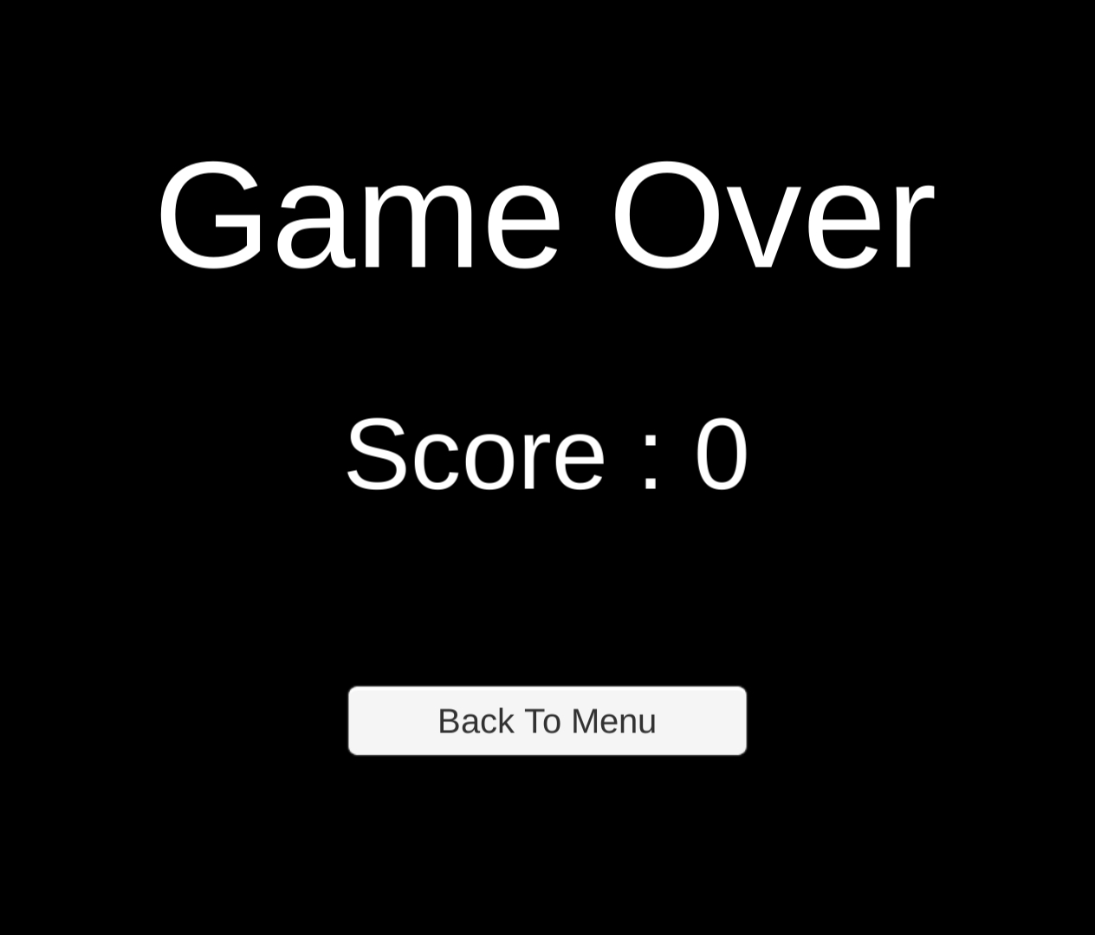
Prototype Screenshots
Game Over

Slide 9
Thank You

